Slide 1
Information Package
The new methodology for determining requirements for a data warehouse system is based on business dimensions.
By using the new methodology the measurements and the relevant dimensions that must be captured and kept in the data warehouse.
This is known as an information package for the specific subject.
Example : information package for analysing sales for a certain business.
The subject here is sales.
The measured facts are shown in the bottom section of the package diagram.
actual sales, forecast sales, and bud-get sales.
The business dimensions are shown at the top of diagram as column headings.
time, location, product, and demographic age group.
Each of these business dimensions contains a hierarchy or levels.
For example, the time dimension has the hierarchy going from year down to the level of individual day. ( quarter, month, and week).
These levels or hierarchical components are shown in the information package diagram.
Notes:
1

Slide 2
Information Package
Information packages enables to :
Define the common subject areas
Design key business metrics
Decide how data must be presented
Determine how users will aggregate or roll up
Decide the data quantity for user analysis or query
Decide how data will be accessed

Slide 3
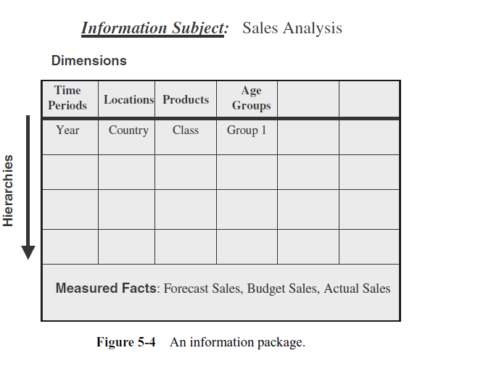
Notes:
3

Slide 4
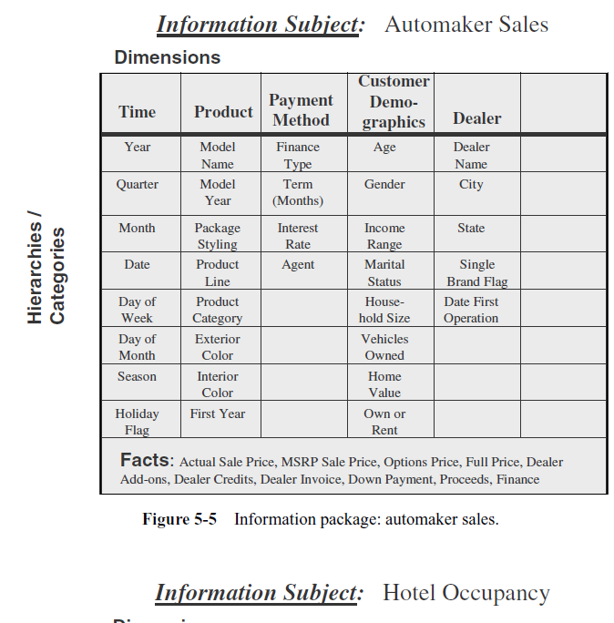

Slide 5
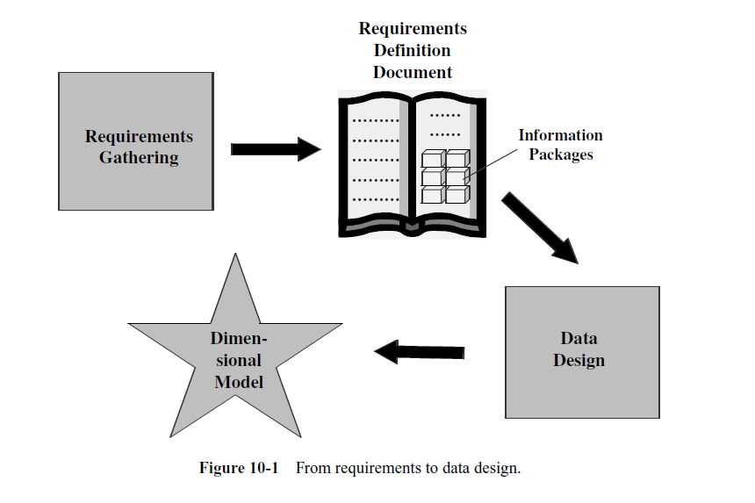
Notes:
5

Slide 6
DIMENSIONAL MODELING
Design Decisions
Choosing the process.
Selecting the subjects from the information packages for the first set of logical structures to be designed.
Choosing the grain.
Determining the level of detail for the data in the data structures.
Identifying and conforming the dimensions.
Choosing the business dimensions (such as product, market, time, etc.) to be included in the first set of structures.
Choosing the facts.
Selecting the metrics or units of measurements (such as product sale units, dollar sales, dollar revenue, etc.) to be included in the first set of structures.
Choosing the duration of the database.
Determining how far back in time you should go for historical data.
Notes:
6

Slide 7
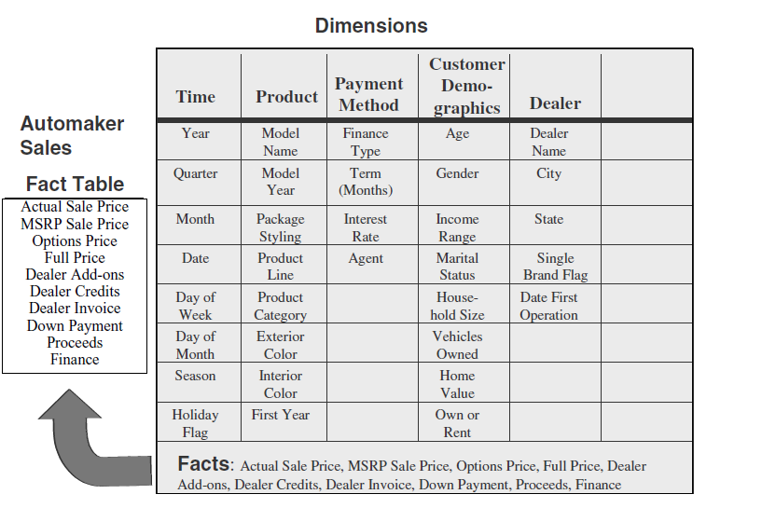
Notes:
7

Slide 8
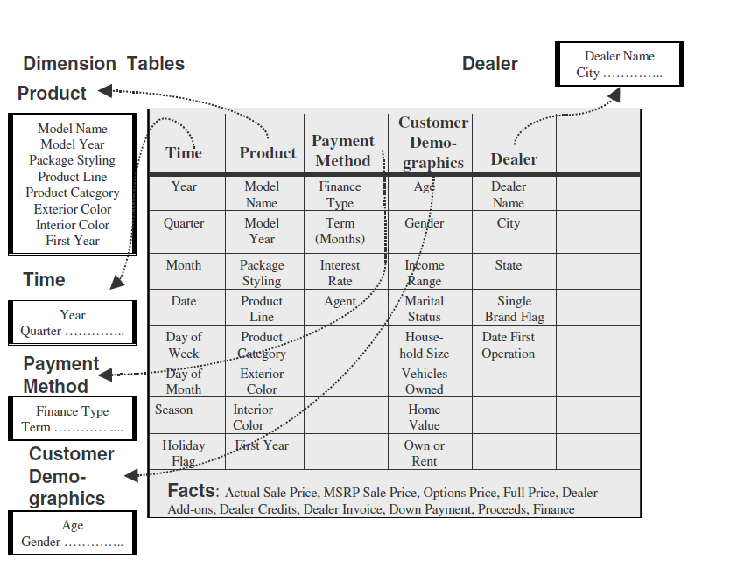
Notes:
8

Slide 9
Criteria for combining the tables into a dimensional model.
The model should provide the best data access.
The whole model must be query-centric.
It must be optimized for queries and analyses.
The model must show that the dimension tables interact with the fact table.
It should also be structured in such a way that every dimension can interact equally with the fact table.
The model should allow drilling down or rolling up along dimension hierarchies.
Notes:
9

Slide 10
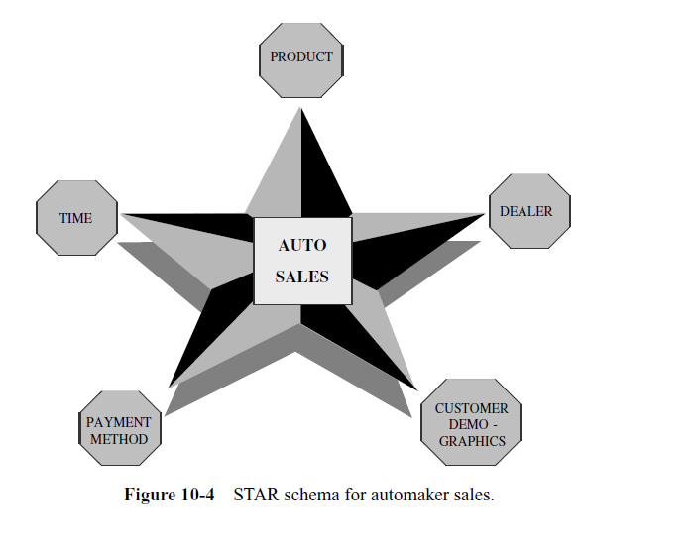
THE STAR SCHEMA

Slide 11
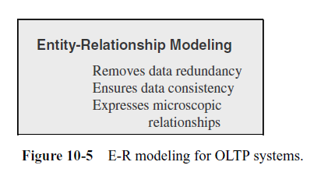
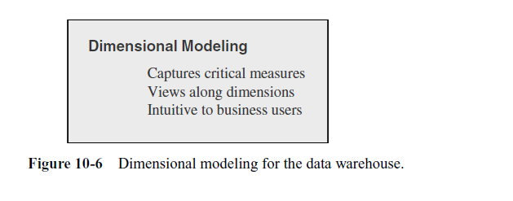

Slide 12
E-R Modeling Versus Dimensional Modeling
E-R Modeling
OLTP systems capture details of events or transactions
OLTP systems focus on individual events
An OLTP system is a window into micro-level transactions
Picture at detail level necessary to run the business
Suitable only for questions at transaction level
Data consistency, non-redundancy, and efficient data storage critical
Notes:
12

Slide 13
E-R Modeling Versus Dimensional Modeling
Dimensional Modeling
DW meant to answer questions on overall process
DW focus is on how managers view the business
DW reveals business trends
Information is centered around a business process
Answers show how the business measures the process
The measures to be studied in many ways along several business dimensions
Notes:
13

Slide 14
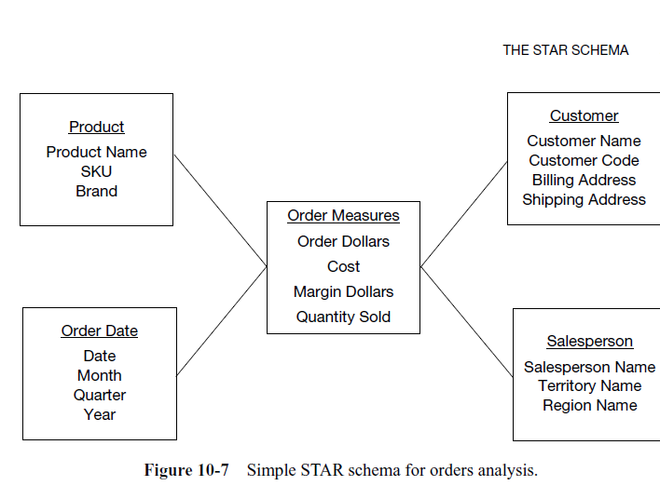

Slide 15
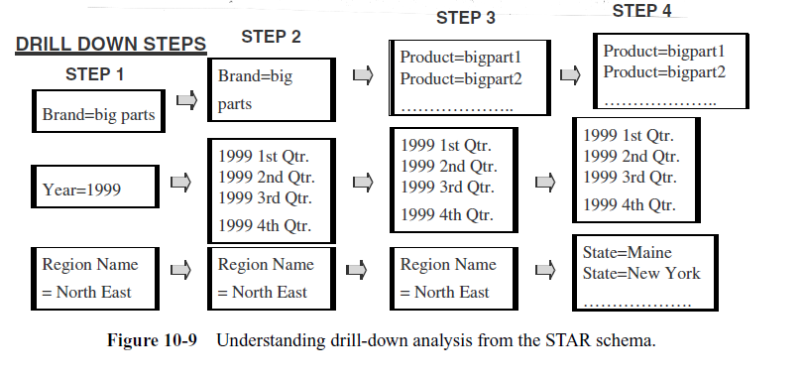

Slide 16
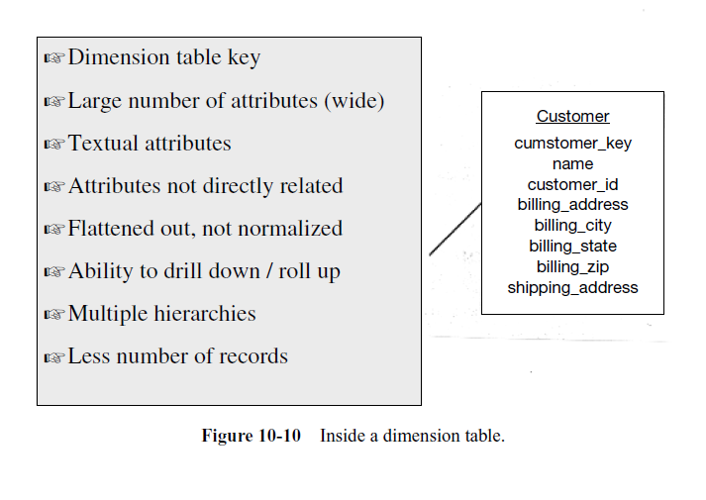
Inside a Dimension Table

Slide 17
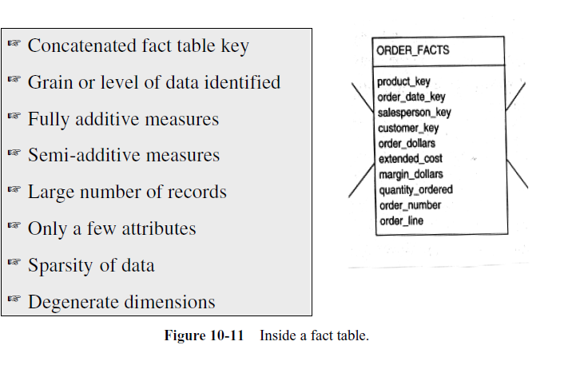
Inside the Fact Table

Slide 18
The Factless Fact Table
For analyzing student attendance, the possible dimensions are
student, course, date, room, and professor.
The attendance may be affected by any of these dimensions.
When you want to mark the attendance relating to a particular course, date, room, and professor, what is the measurement you come up for recording the event?
In the fact table row, the attendance will be indicated with the number one. Every fact table row will contain the number one as attendance.
The very presence of a corresponding fact table row could indicate the attendance.
This type of situation arises when the fact table represents events. Such fact tables really do not need to contain facts.
They are “factless” fact tables.
Notes:
18

Slide 19
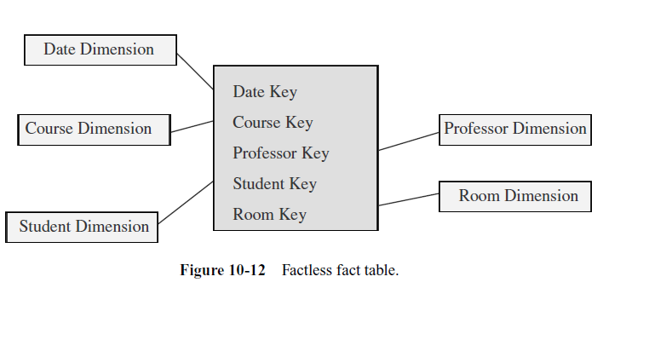
The Factless Fact Table

Slide 20
Keys in the Data Warehouse Schema
Primary Keys
Each row in a dimension table is identified by a unique value of an attribute designated as the primary key of the dimension.
In a product dimension table-primary key identifies each product uniquely.
In the customer dimension table, the customer number identifies each customer uniquely.
In the sales representative dimension table, the social security number of the sales representative identifies each sales representative.

Slide 21
Keys in the Data Warehouse Schema
some implications of these candidate keys.
Assume that the product code in the operational system is an 8-position code,
two of which positions indicate the code of the warehouse where the product is normally stored,
two other positions denote the product category.
If we use the product code as the primary key.
If the product code gets changed in the middle of a year then
then the aggregate data before the change and after the change to the product code.

Slide 22
Keys in the Data Warehouse Schema
Surrogate Keys
The surrogate keys are simply system-generated sequence numbers.
They do not have any built-in meanings.
The surrogate keys will be mapped to the production system keys.
Keep the operational system keys as additional attributes in the dimension tables.

Slide 23
Keys in the Data Warehouse Schema

Slide 24
Keys in the Data Warehouse Schema
Foreign Keys
Each dimension table is in a one-to-many relationship with the central fact table.
So the primary key of each dimension table must be a foreign key in the fact table.
If there are four dimension tables of product, date, customer, and sales representative, then the primary key of each of these four tables must be present in the orders fact table as foreign keys.

Slide 25
Keys in the Data Warehouse Schema
The primary keys for the fact tables
1. A single compound primary key whose length is the total length of the keys of the individual dimension tables.
increases the size of the fact table (compound primary key, + the foreign keys).
2. Concatenated primary key that is the concatenation of all the primary keys of the dimension tables.
3. A generated primary key independent of the keys of the dimension tables.
Increases the size of the fact table (generated primary key)

Slide 26
THE SNOWFLAKE SCHEMA
“Snowflaking” is a method of normalizing the dimension tables in a STAR schema.
Partially normalize only a few dimension tables, leaving the others intact.
Partially or fully normalize only a few dimension tables, leaving the rest intact.
Partially normalize every dimension table.
Fully normalize every dimension table

Slide 27
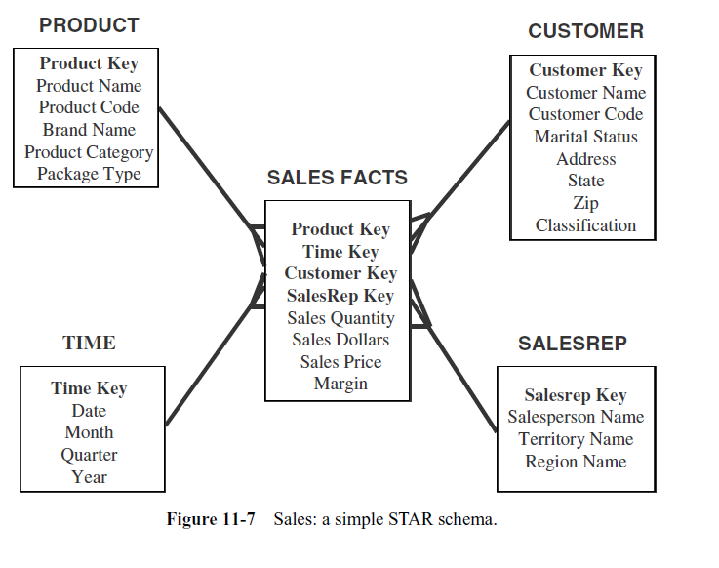
THE STAR SCHEMA

Slide 28
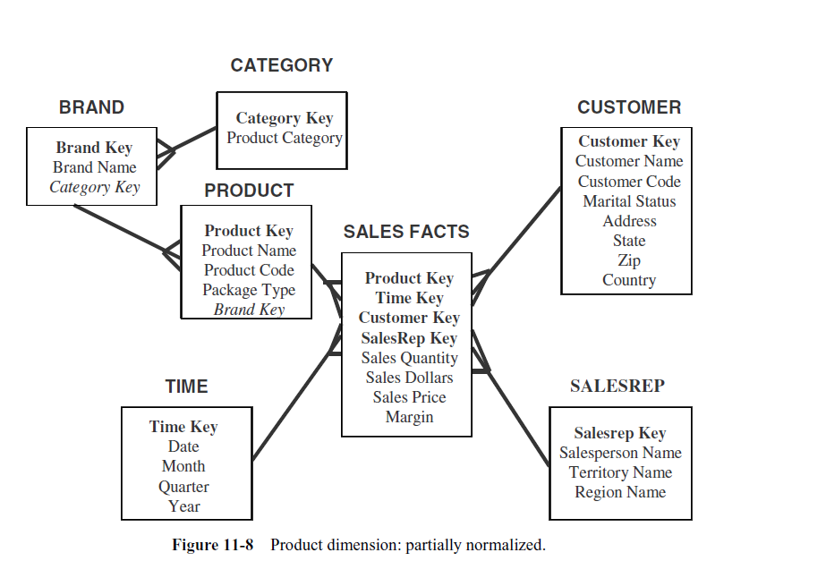
THE SNOWFLAKE SCHEMA

Slide 29
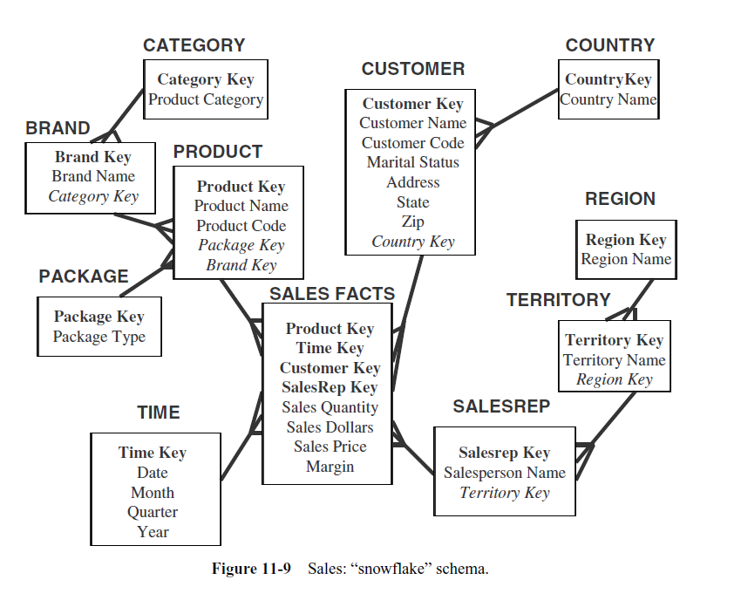
THE SNOWFLAKE SCHEMA

Slide 30
UPDATES TO THE DIMENSION TABLES
The dimension tables are more stable and less volatile.
The fact table, which changes through the increase in the number of rows
A dimension table does not change just through the increase in the number of rows, but also through changes to the attributes themselves.
If a particular product is moved to a different product category, then the corresponding values must be changed in the product dimension table.
The types of changes that affect dimension tables and discuss the ways for dealing with these types.

Slide 31
Slowly Changing Dimensions
Most dimensions are generally constant over time
Many dimensions, though not constant over time, change slowly
The product key of the source record does not change
The description and other attributes change slowly over time
In the source OLTP systems, the new values overwrite the old ones
Overwriting of dimension table attributes is not always the appropriate option in a
data warehouse
The ways changes are made to the dimension tables depend on the types of changes and what information must be preserved in the data warehouse

Slide 32
Three types of dimension table changes
Type 1 Changes: Correction of Errors
Type 2 Changes: Preservation of History
Type 3 Changes: Tentative Soft Revisions

Slide 33
Type 1 Changes
The general principles for Type 1 changes:
Usually, the changes relate to correction of errors in source systems
Sometimes the change in the source system has no significance
The old value in the source system needs to be discarded
The change in the source system need not be preserved in the data warehouse
Method for applying Type 1 changes is:
Overwrite the attribute value in the dimension table row with the new value
The old value of the attribute is not preserved
No other changes are made in the dimension table row
The key of this dimension table or any other key values are not affected
This type is easiest to implement

Slide 34
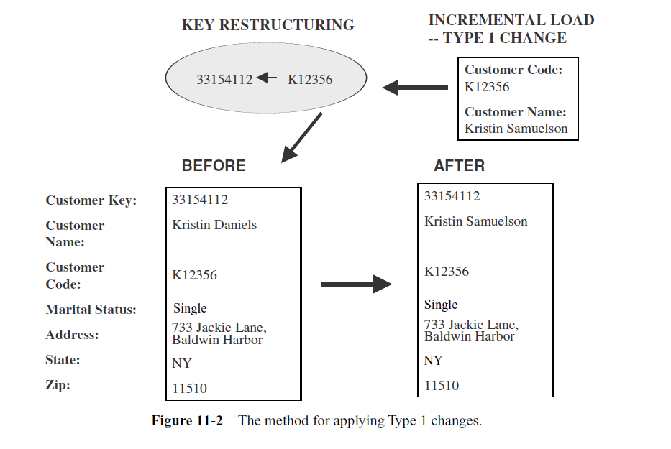
Type 1 Changes

Slide 35
Type 2 Changes
The general principles for this Type 2 of changes
They usually relate to true changes in source systems
There is a need to preserve history in the data warehouse
This type of change partitions the history in the data warehouse
Every change for the same attribute must be preserved
The method for applying Type 2 changes is:
Add a new dimension table row with the new value of the changed attribute
An effective date field may be included in the dimension table
There are no changes to the original row in the dimension table
The key of the original row is not affected
The new row is inserted with a new surrogate key

Slide 36
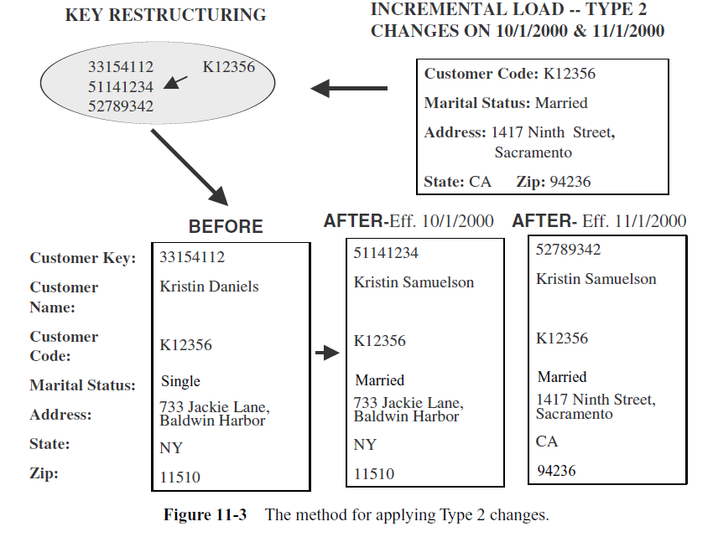
Type 2 Changes

Slide 37
Type 3 Changes
The general principles for Type 3 changes:
They usually relate to “soft” or tentative changes in the source systems
There is a need to keep track of history with old and new values of the changed attribute
They are used to compare performances across the transition
They provide the ability to track forward and backward
The methods for applying Type 3 changes are:
Add an “old” field in the dimension table for the affected attribute
Push down the existing value of the attribute from the “current” field to the “old” field
Keep the new value of the attribute in the “current” field
Also, you may add a “current” effective date field for the attribute

Slide 38
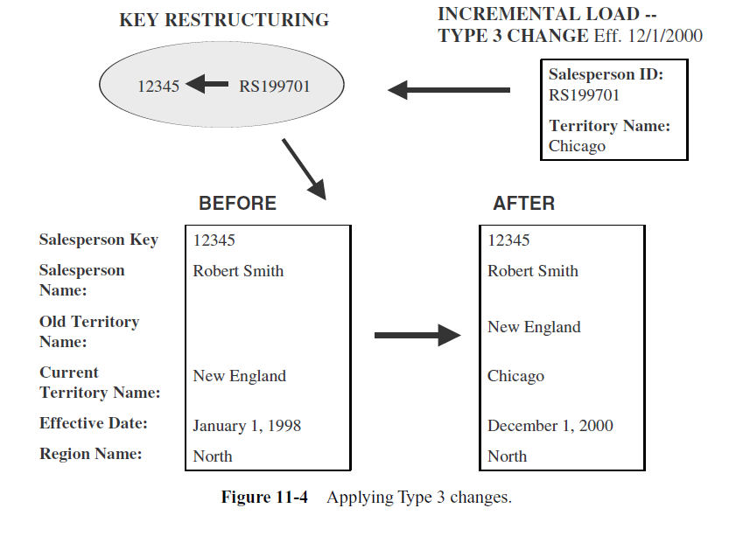
Type 3 Changes

Slide 39
MISCELLANEOUS DIMENSIONS
Large Dimensions
A large dimension is very deep(very large number of rows).
A large dimension may also be very wide ( large number of attributes).
Issues
Population of very large dimension tables
Browse performance of unconstrained dimensions, especially where the cardinality of the attributes is low
Browsing time for cross-constrained values of the dimension attributes
Inefficiencies in fact table queries when large dimensions need to be used
Additional rows created to handle Type 2 slowly changing dimensions

Slide 40
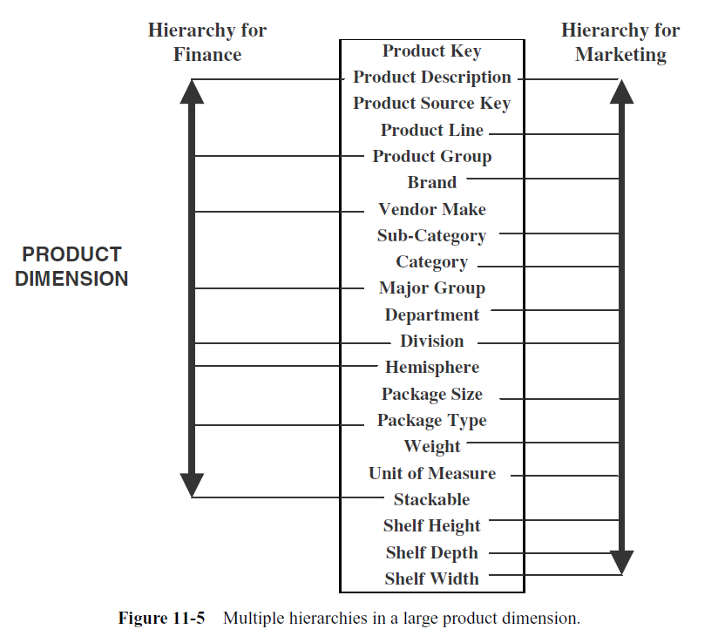
Large Dimensions
Multiple Hierarchies

Slide 41
Rapidly Changing Dimensions
Break off the rapidly changing attributes into another dimension table
Leaving the slowly changing attributes behind in the original table.

Slide 42
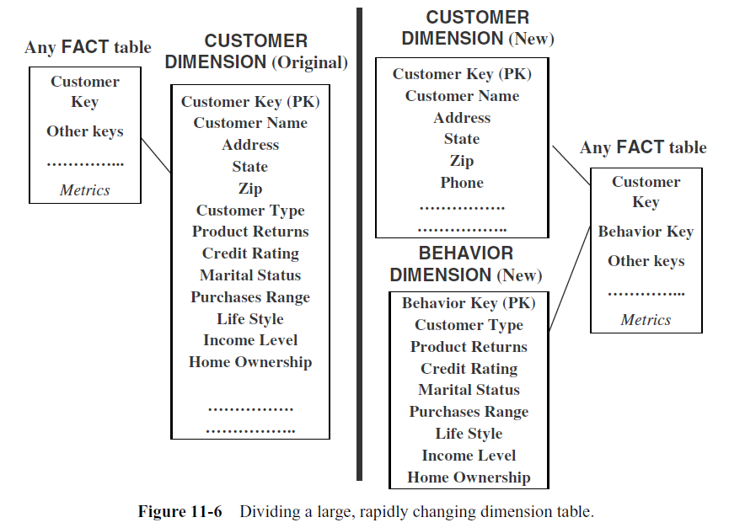

Slide 43
Junk Dimensions
Exclude and discard all flags and texts.
not a good option because you are likely to throw away some useful information.
Place the flags and texts unchanged in the fact table.
This option is likely to swell up the fact table to no specific advantage.
Make each flag and text a separate dimension table on its own.
The number of dimension tables will greatly increase.
Keep only those flags and texts that are meaningful;
Group all the useful flags into a single “junk” dimension.
“Junk” dimension attributes are useful for constraining queries based on flag/text values

Slide 44
AGGREGATE FACT TABLES
Aggregates are precalculated summaries derived from the most granular fact table.
These summaries form a set of separate aggregate fact tables.
Create each aggregate fact table as a specific summarization across any number of dimensions.
Query : Total sales for all customers in the South-Central territory for the first two quarters of 2000 for product category Bigtools.
Qualifying rows:
All fact table rows where the customer key relates to all customers in the South-Central territory, the product key relates to all products in the product category Bigtools, and the time key relates to about 180 days in the first two quarters of 2000. A large number of fact table rows participate in the summation.

Slide 45
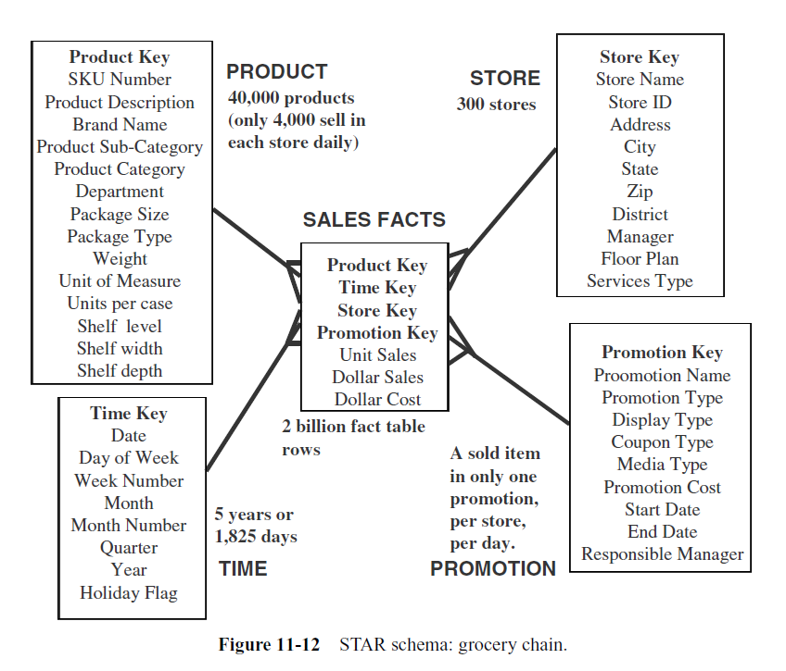

Slide 46
Multi-Way Aggregate Fact Tables.
One-Way Aggregates.
When you rise to higher levels in the hierarchy of one dimension and keep the level at the lowest in the other dimensions, you create one-way aggregate tables.
Two-Way Aggregates.
When you rise to higher levels in the hierarchies of two dimensions and keep the level at the lowest in the other dimension, you create two-way aggregate tables.
Three-Way Aggregates.
When you rise to higher levels in the hierarchies of all the three dimensions, you create three-way aggregate tables.

Slide 47
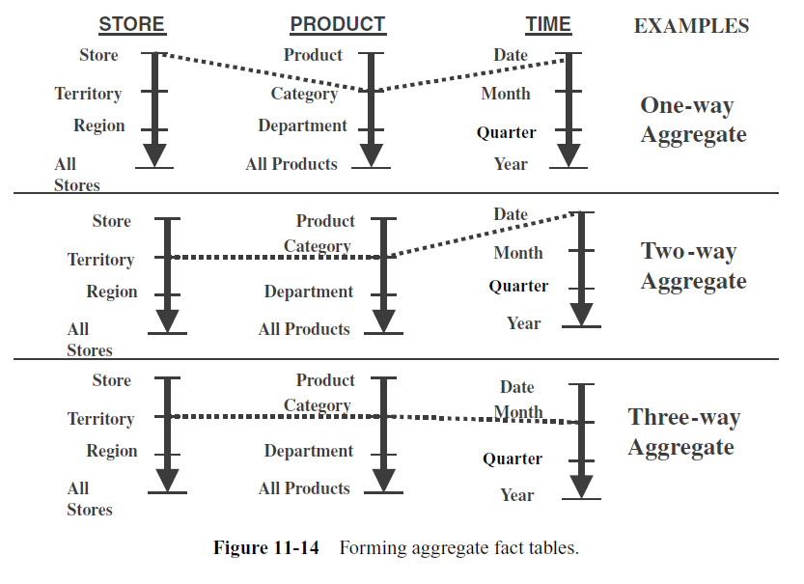
Multi-Way Aggregate

Slide 48
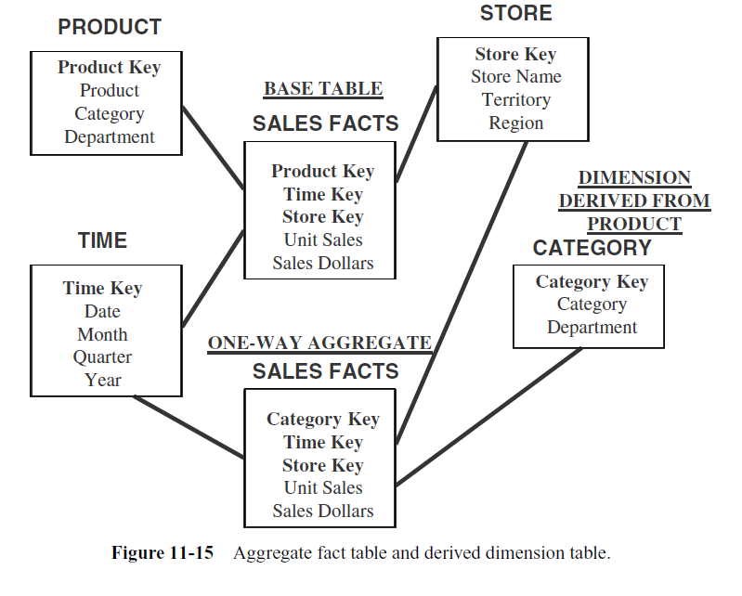

Slide 49
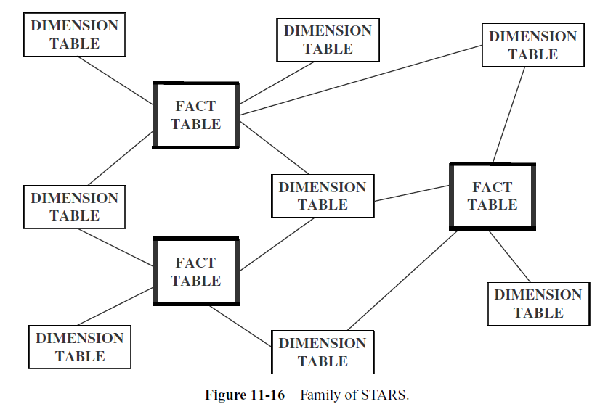
Families Of STARS / Fact Constellation Schema

Slide 50
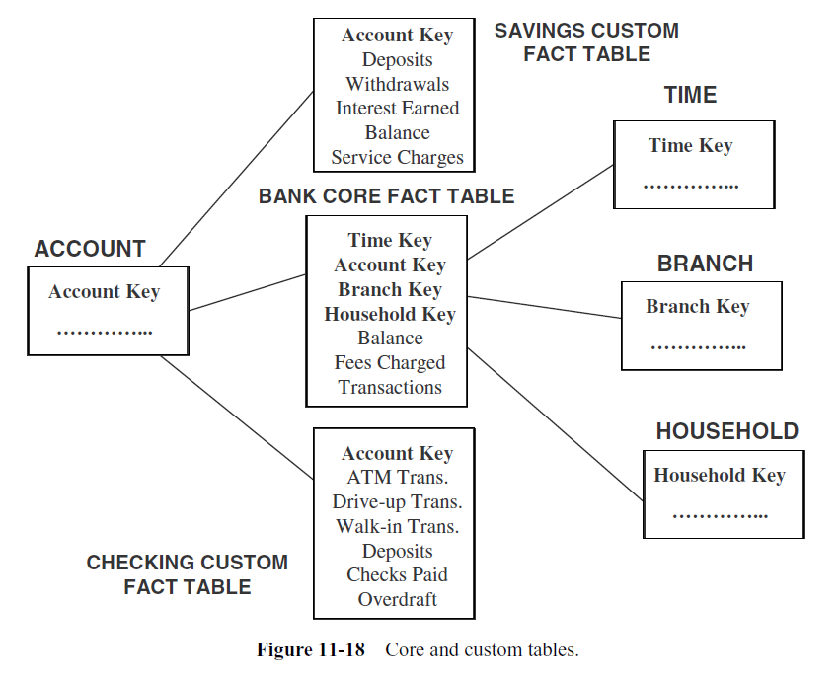

Slide 51
